Slide 1
Phishing URL Detection using Machine Learning
22015775 | Sheneeza Chaudhary

Slide 2
Table of contents
01
02
03
Introduction
Problem Domain
Project Scope
04
05
06
Dataset
Data Exploration
Model Selection

Slide 3
Table of contents
07
08
09
Hyperparameter Tuning
Training and Testing
Peformance Metrics
10
11
Results
Conclusion

Slide 4
Introduction
01

Slide 5
Brief Overview
Phishing threats have become ubiquitous in the digital landscape, posing significant challenges to cybersecurity. The sophistication of these threats, coupled with the ever-expanding internet ecosystem, underscores the need for advanced detection mechanisms. Cybercriminals employ deceptive tactics to create malicious URLs that mimic legitimate websites, making it imperative to address this pervasive issue. The prevalence of phishing attacks has escalated, leading to financial losses, data breaches, and compromised user privacy.

Slide 6
Project Objectives
DEVELOP MACHINE LEARNING MODELS
Create robust machine learning models capable of accurately detecting and categorizing phishing URLs.
USER SAFETY
Prioritize user safety by developing a system that safeguards against potential risks associated with phishing activities, ultimately creating a more secure online environment.
CONTRIBUTE TO CYBERSECURITY
Provide a meaningful contribution to the field of cybersecurity by implementing advanced algorithms that address the challenges posed by evolving phishing threats.

Slide 7
02
Problem Domain

Slide 8
In the current digital landscape, the proliferation of malicious URLs poses a significant challenge to cybersecurity. The rapid increase in the number of these URLs complicates the task of distinguishing secure websites from potentially dangerous ones. As internet platforms expand, the task of quickly identifying and categorizing malicious URLs becomes more difficult, allowing cyber threats to flourish. This growth is particularly concerning as it puts user data at risk, with new websites created daily, making it challenging to keep pace with potential threats.

Slide 9
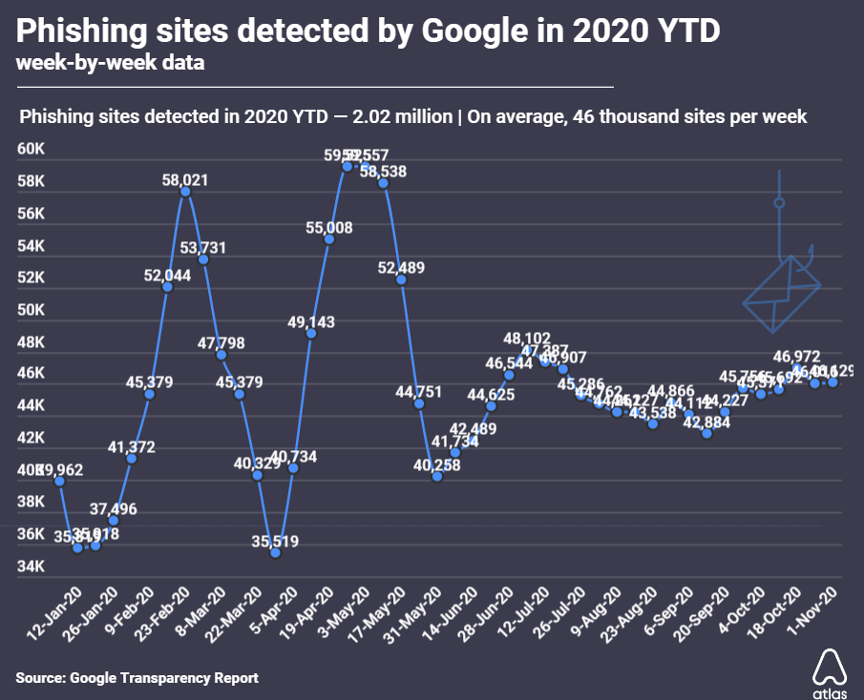
Awesome words

Slide 10
03
Project Scope

Slide 11
The project focuses on addressing the critical issue of URL phishing, aiming to enhance the detection mechanisms employed in cybersecurity. In an era marked by the expansive growth of internet platforms, the distinction between secure and malicious websites has become increasingly challenging. This project's scope encompasses the development of advanced systems dedicated to identifying and categorizing harmful URLs effectively. By leveraging machine learning algorithms, the project seeks to contribute to the improvement of defense mechanisms against evolving cyber threats, particularly those associated with phishing attacks.

Slide 12
04
Dataset

Slide 13
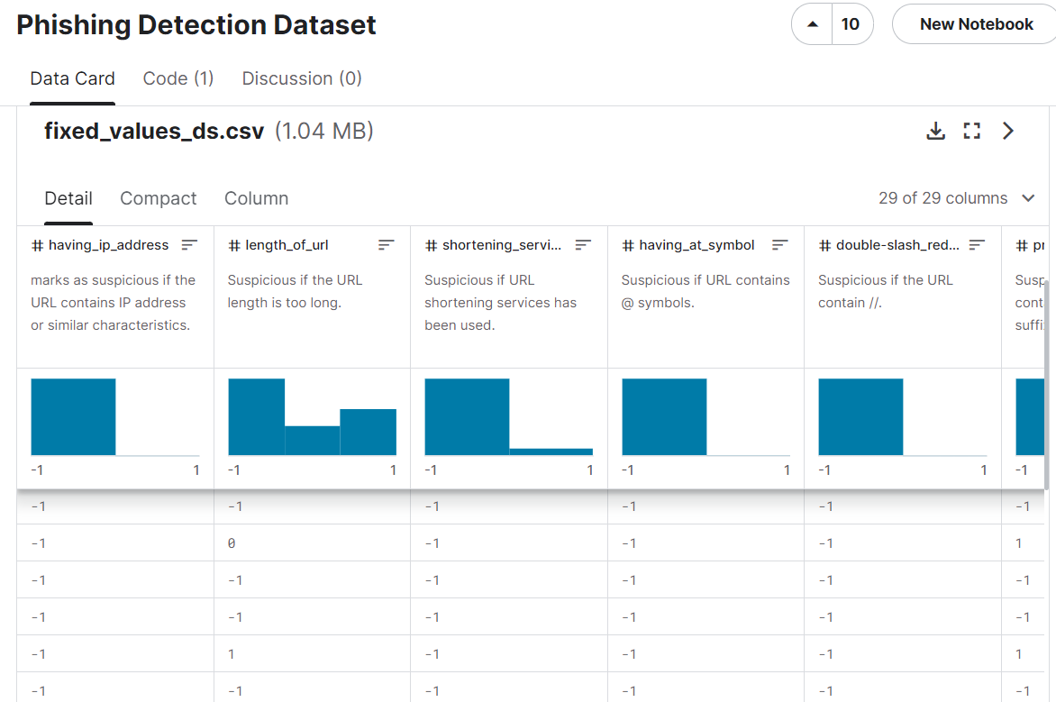

Slide 14
Reasons for choosing this dataset
Source and Authenticity
Size & Diversity
Reasons
Relevance to problem
Feature Richness

Slide 15
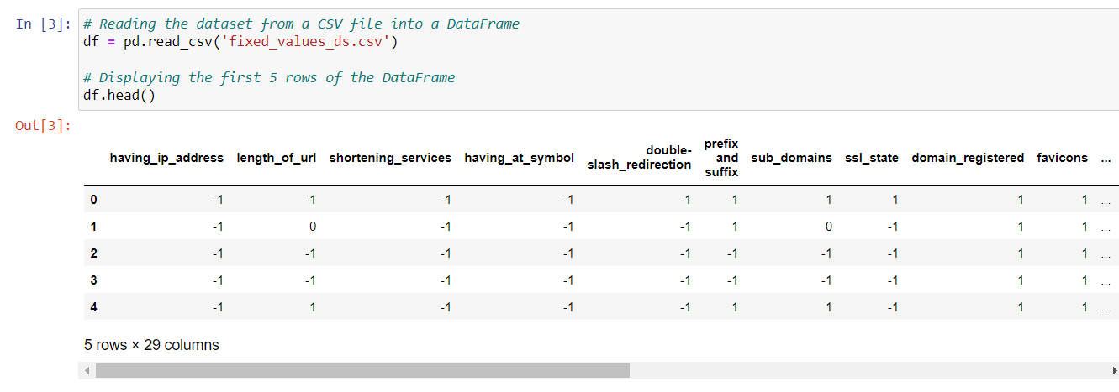
Loading Dataset

Slide 16
05
Data Exploration

Slide 17
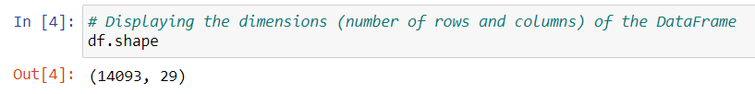
Displaying dimensions of DataFrame

Slide 18
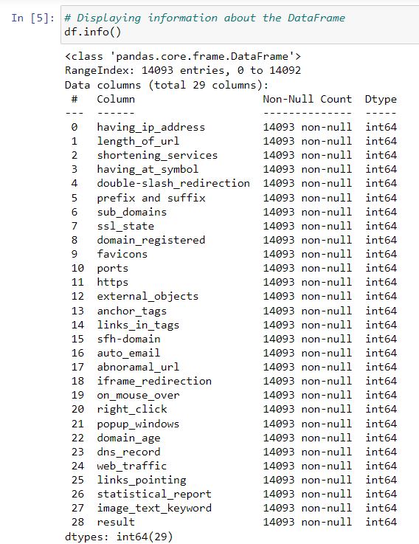
Displaying info about DataFrame

Slide 19
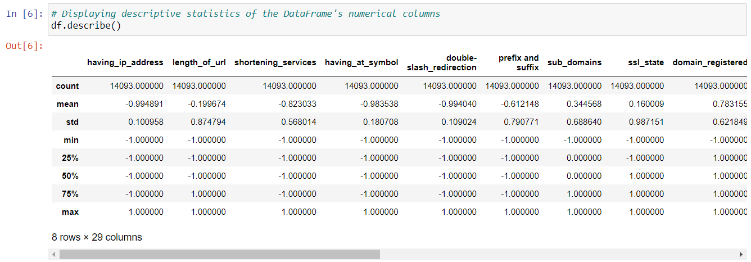
Displaying statistics of each column

Slide 20
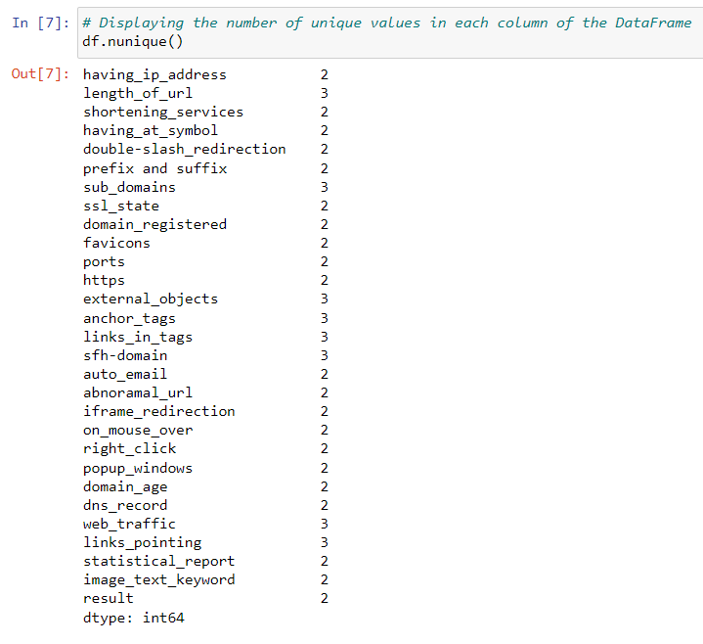
Displaying number of unique values in each column

Slide 21
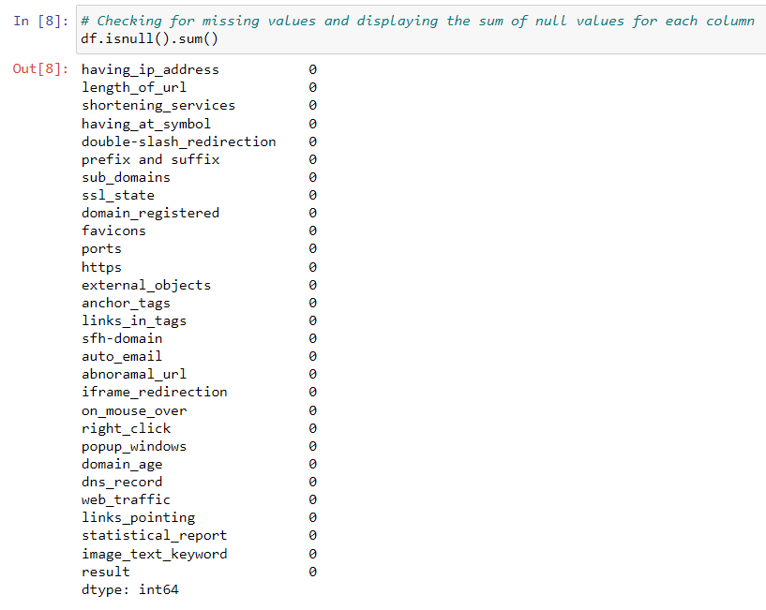
Checking for missing values and displaying the sum of null values

Slide 22
06
Model Selection

Slide 23
Selected Algorithms
Random Forest
K-Nearest Neighbors (KNN)
Leverages ensemble learning for improved accuracy
Due to pattern recognition
Gaussian Naïve Bayes
Support Vector Machines (SVM)
Effective in probabilistic modeling
Handles complex data patterns

Slide 24
07
Hyperparameter Tuning

Slide 25
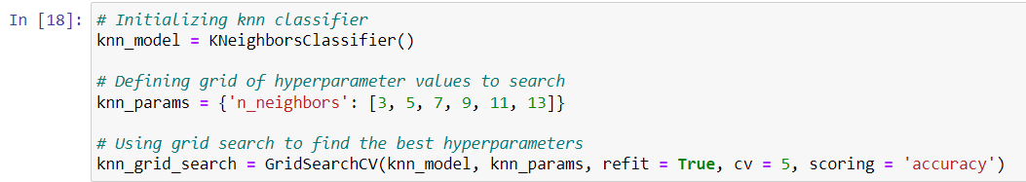
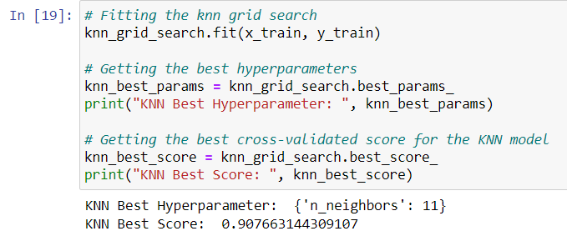
K-Nearest Neighbors (KNN)

Slide 26
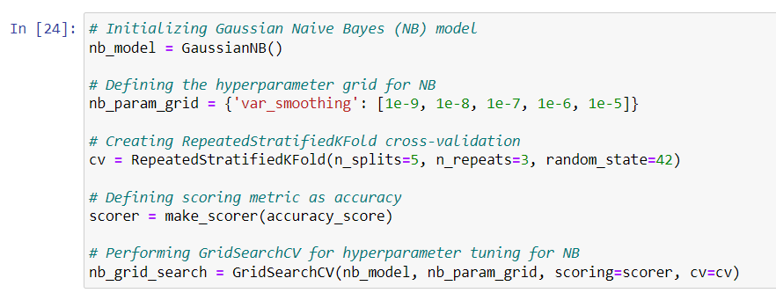
Gaussian Naïve Bayes

Slide 27
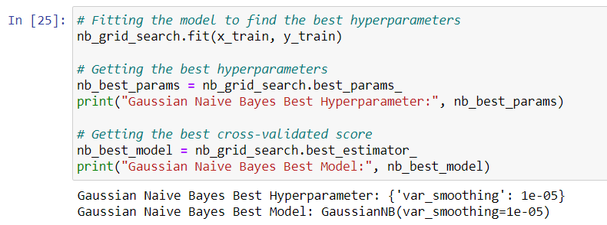
Gaussian Naïve Bayes

Slide 28
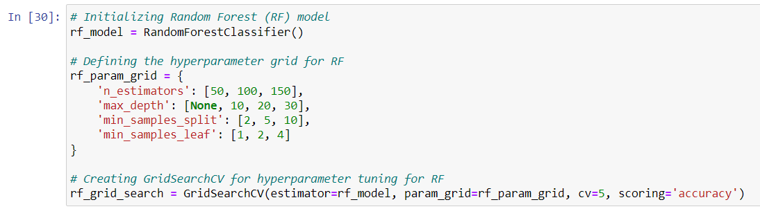
Random Forest

Slide 29
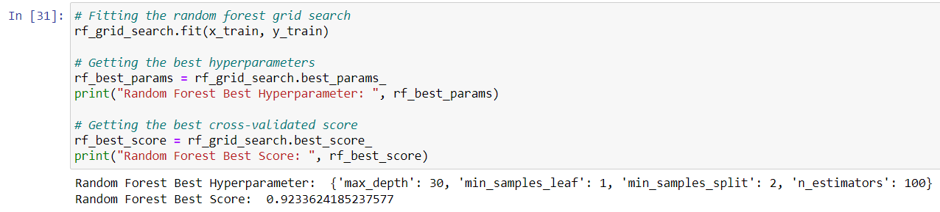
Random Forest

Slide 30
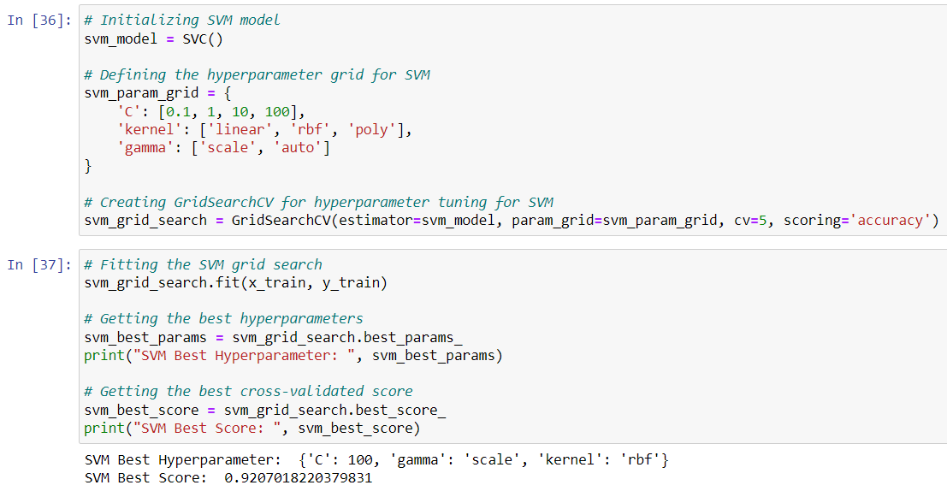
Support Vector Machines (SVM)

Slide 31
Support Vector Machines (SVM)

Slide 32
08
Training and Testing

Slide 33
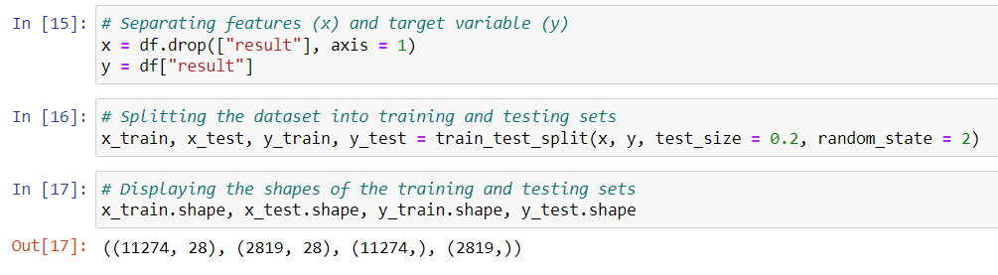
Splitting data into train and test

Slide 34
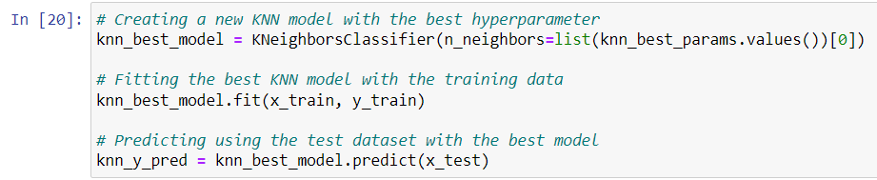
K-Nearest Neighbors (KNN)

Slide 35
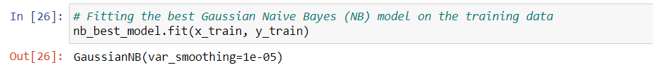
Gaussian Naïve Bayes

Slide 36
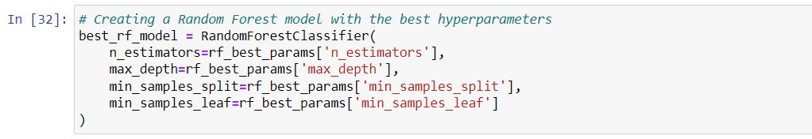
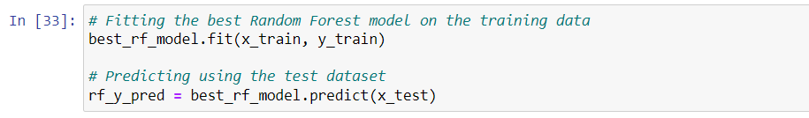
Random Forest

Slide 37
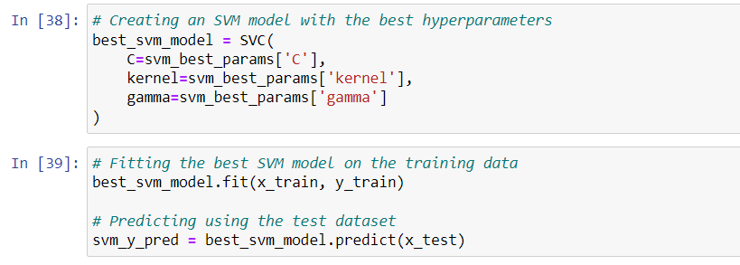
Support Vector Machines (SVM)

Slide 38
09
Performance Metrics

Slide 39
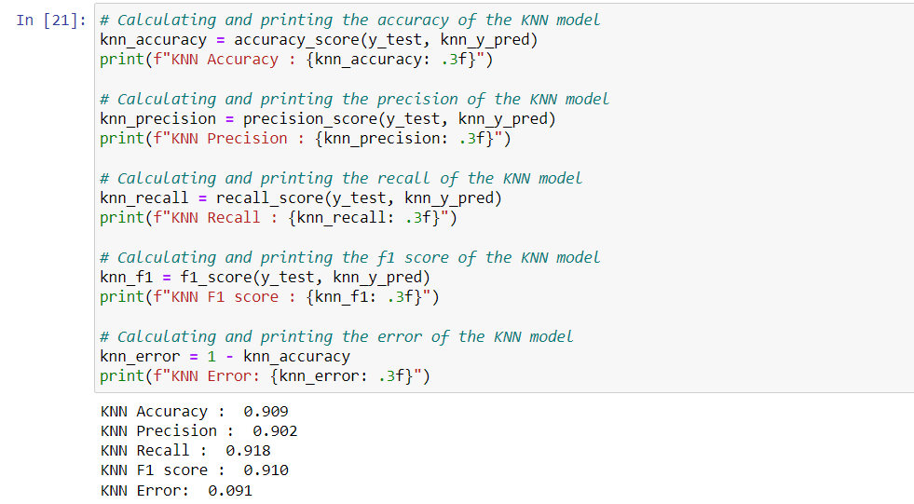
K-Nearest Neighbors (KNN)

Slide 40
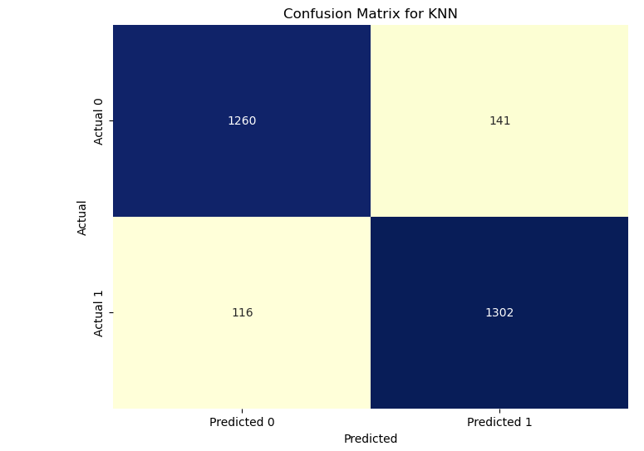
K-Nearest Neighbors (KNN)

Slide 41
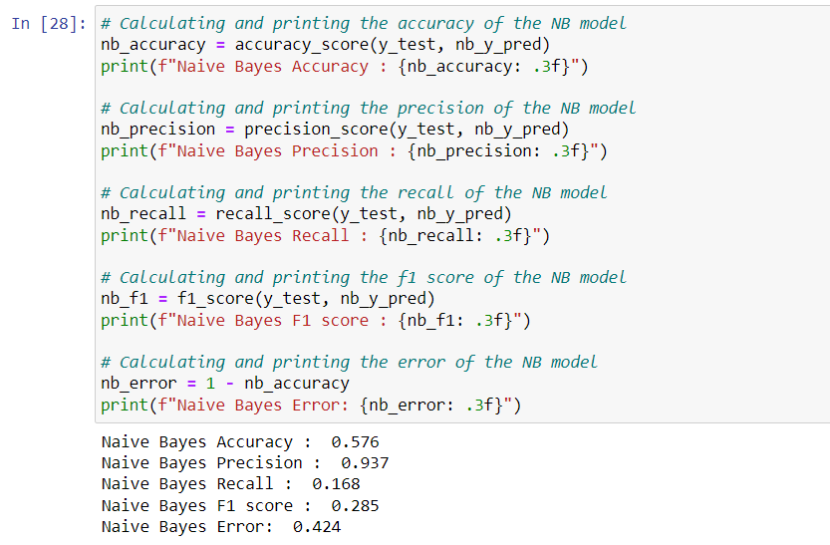
Gaussian Naïve Bayes

Slide 42
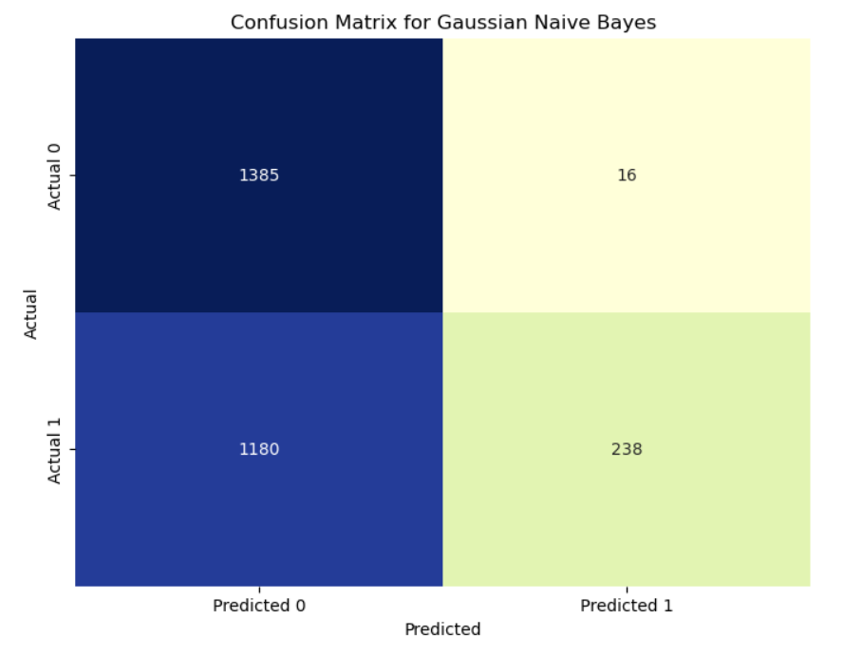
Gaussian Naïve Bayes

Slide 43
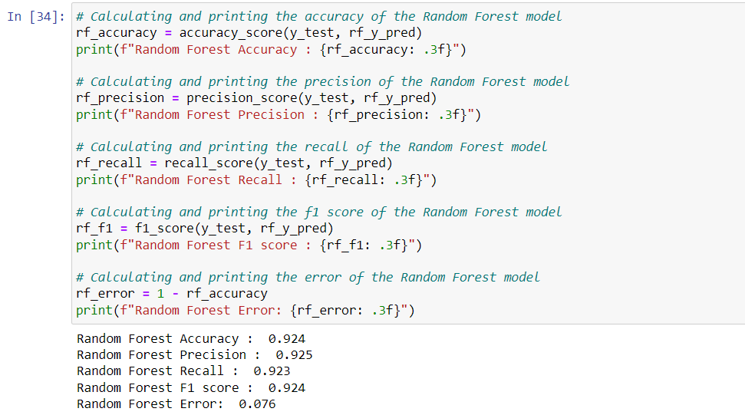
Random Forest

Slide 44
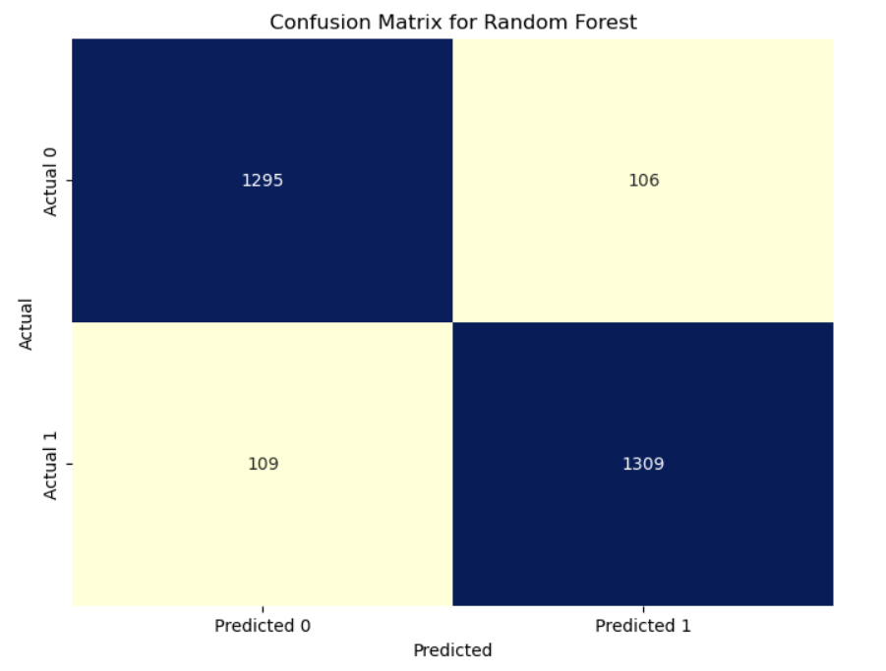
Random Forest

Slide 45
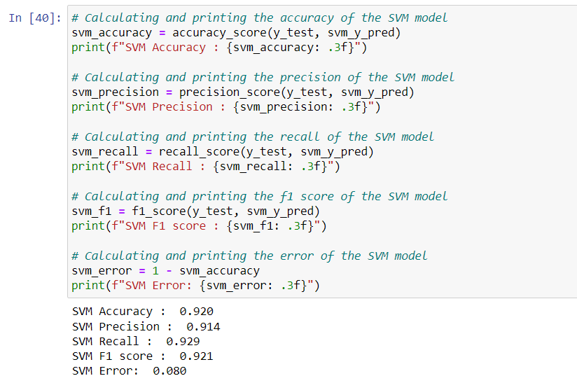
Support Vector Machines (SVM)

Slide 46
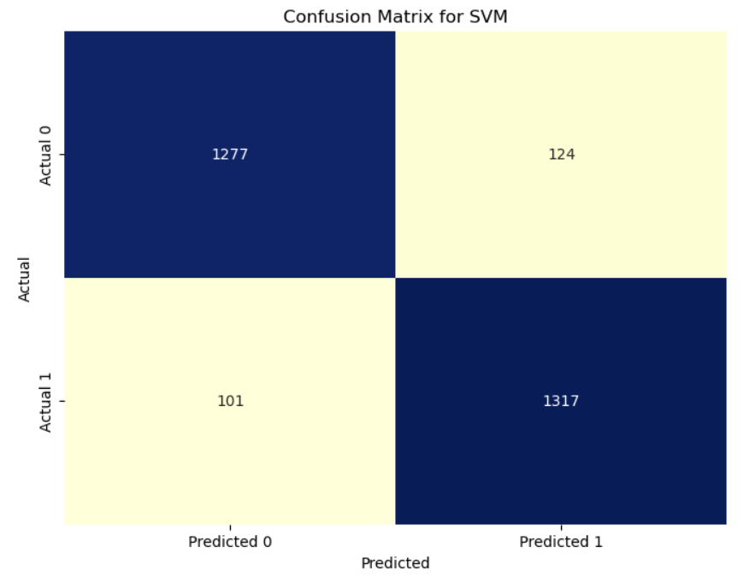
Support Vector Machines (SVM)

Slide 47
10
Results

Slide 48
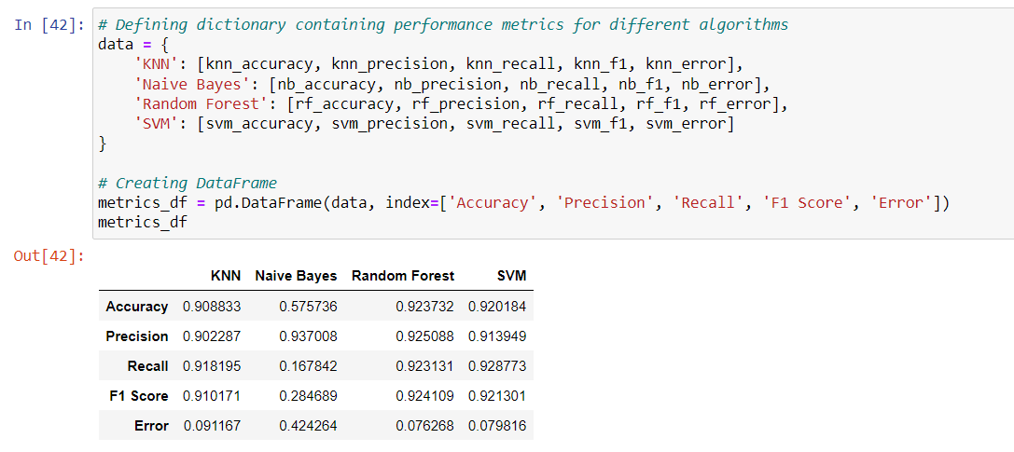
Performance Metrics

Slide 49
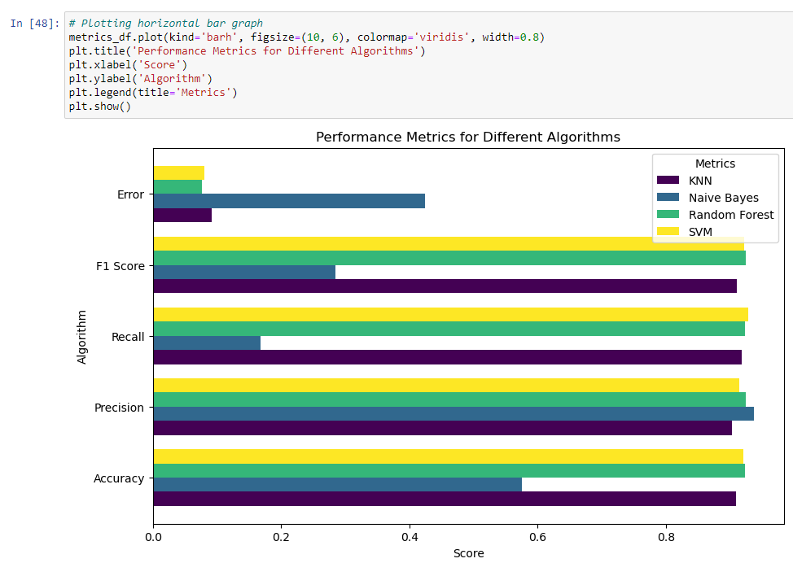
Performance Metrics

Slide 50
11
Conclusion

Slide 51
In conclusion, the project has provided valuable insights into the realm of cybersecurity, specifically within the domain of URL phishing detection. Through rigorous analysis and implementation of machine learning algorithms, significant progress has been made in improving the identification of malicious URLs. Key findings underscore the effectiveness of ensemble learning in Random Forest, the probabilistic modeling strength of Naive Bayes, and the adaptability of Support Vector Machines. These collective discoveries contribute to a more comprehensive understanding of threats associated with malicious URLs.

